Slide 1
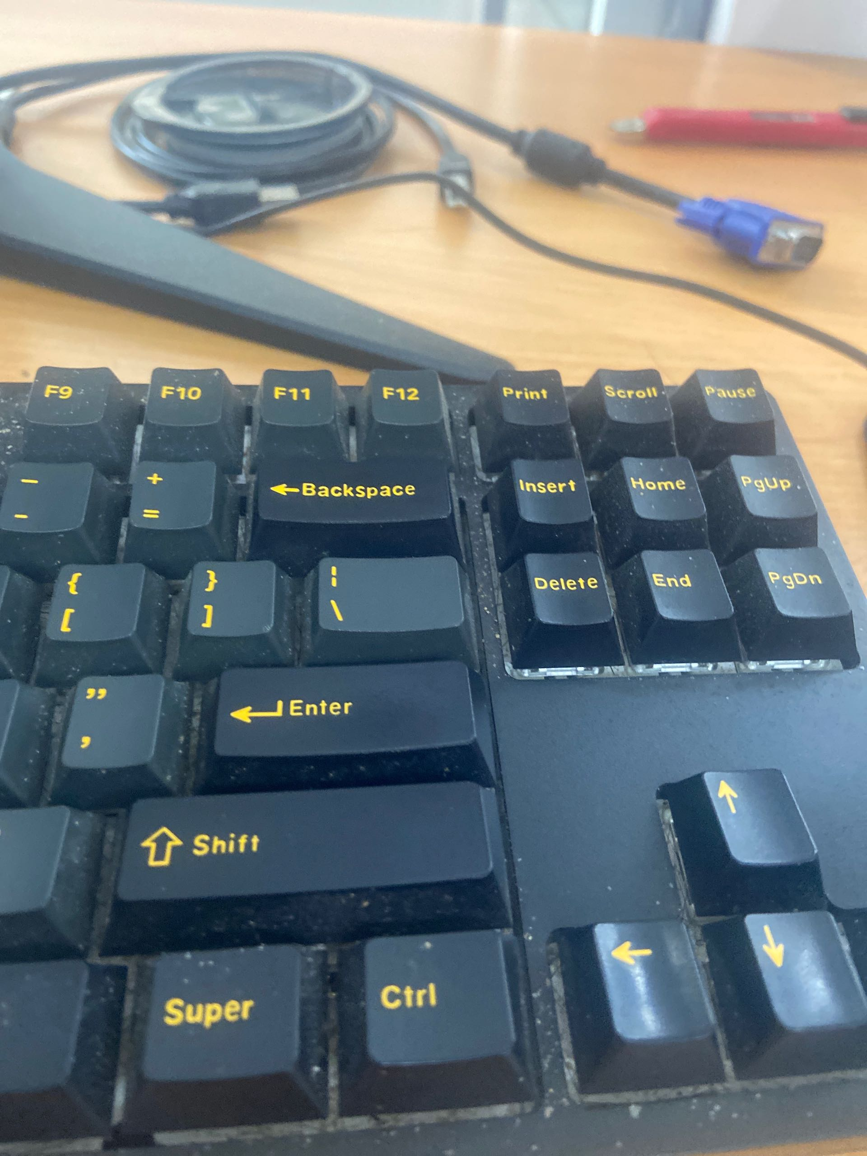
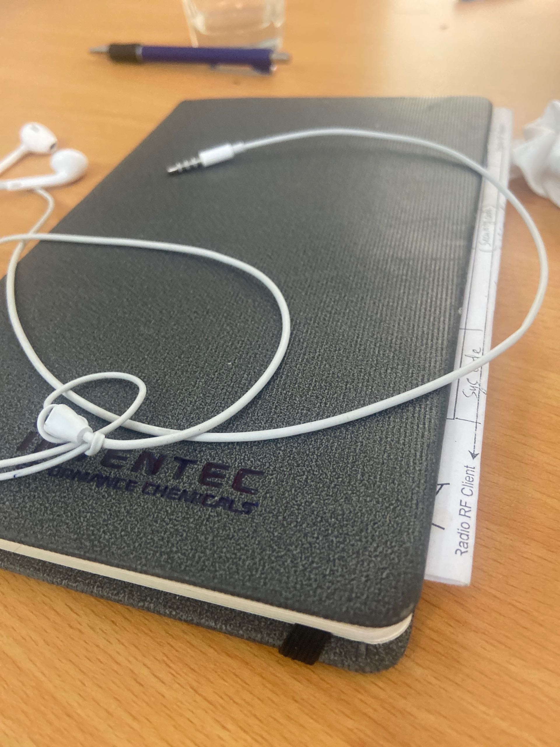
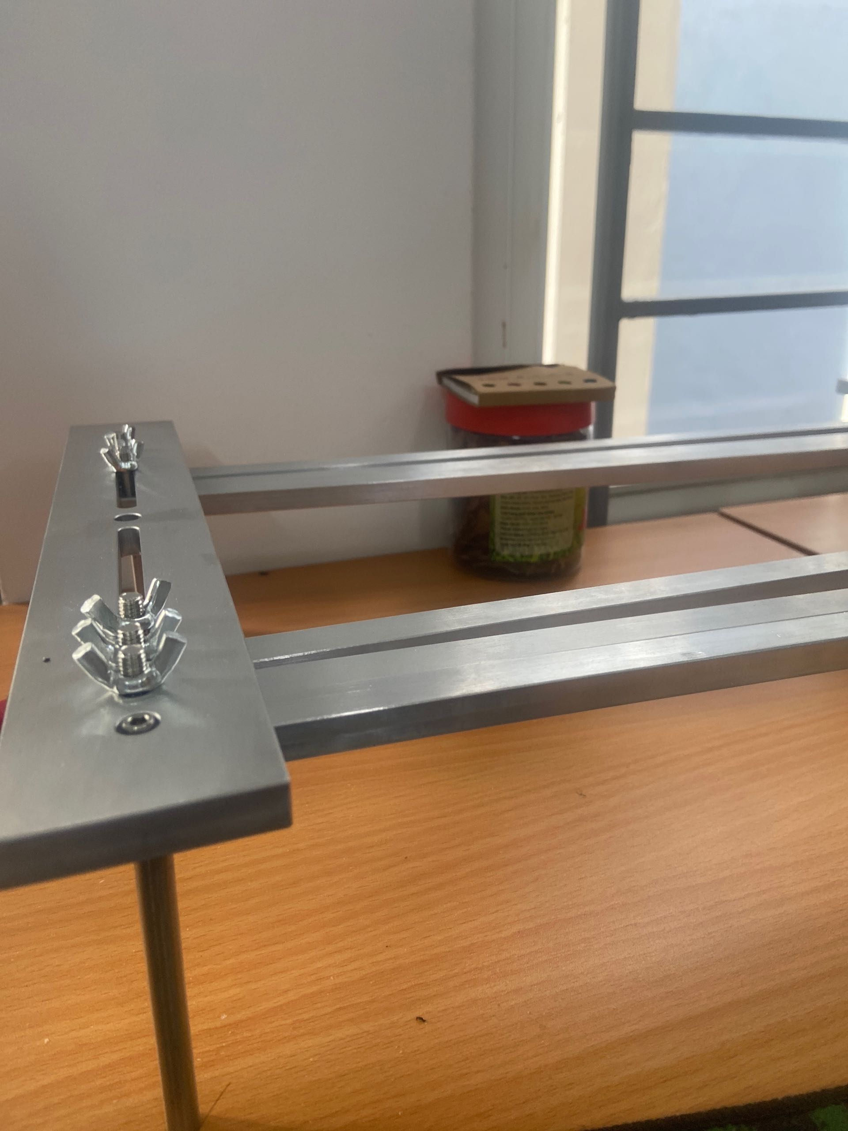
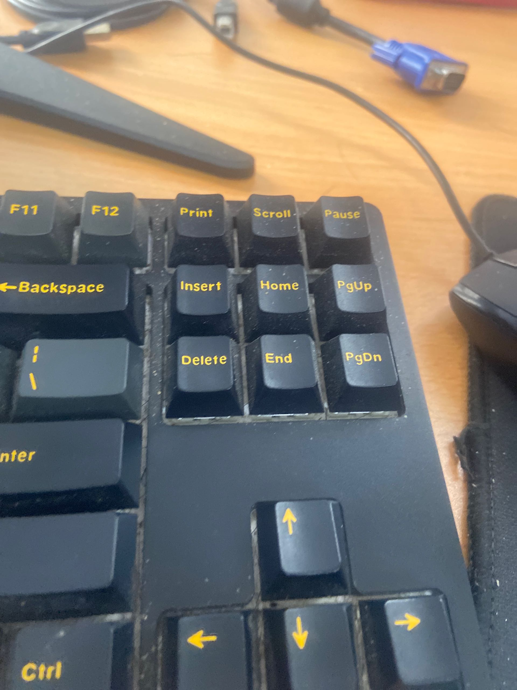
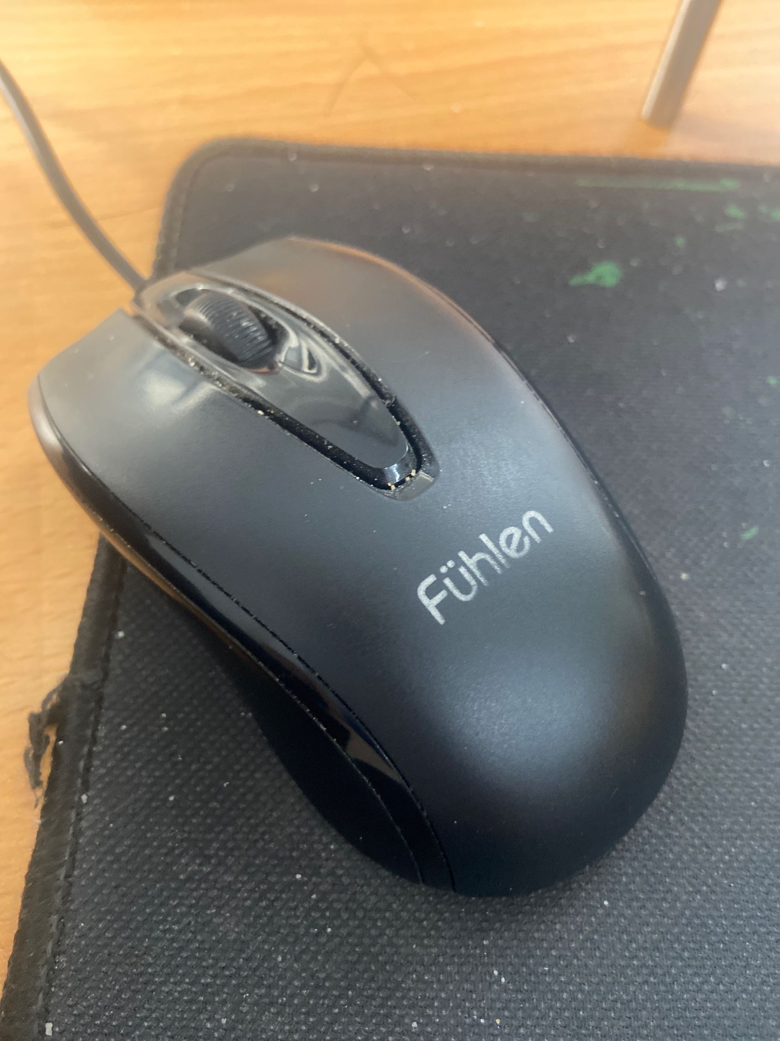
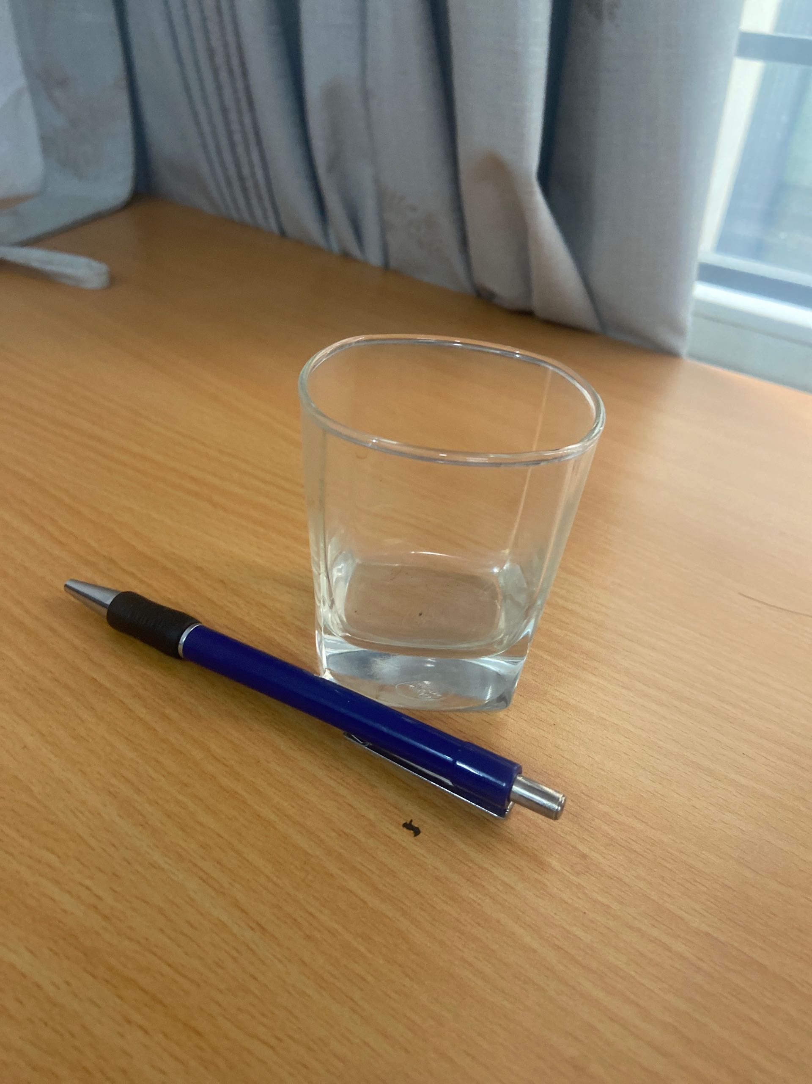
TR20240807_0000
admin
tb_checked
Vũ Đình Nam
CONVEYOR INVECTOR 1.1 TOP
07.08.2024
02h34
Không lỗi 123
08h43
1.1-Top
369 Min
Issue 1234567
Action 1234
Action 4567
BEFORE
AFFTER
Checking 12345
Result 1234
Checking 5678
1/1

